Slide 1

BLUESTOCK MUTUAL FUND ANALYTICS PROJECT
End-to-End Mutual Fund Analytics, Risk Assessment & Dashboard Development
Submitted By : Bindu

Slide 2

PROJECT OVERVIEW
Goal :
Build a complete analytics platform for mutual fund performance, investor behavior, risk assessment, and business intelligence reporting.
Key Deliverables:
ETL Pipeline.
SQLite Data Warehouse.
Exploratory Data Analysis
Performance Analytics
Risk Analytics
Recommendation Engine
Power BI Dashboard

Slide 3
DATA SOURCES
Dataset
Purpose
Fund Master
Scheme metadata
NAV History
Historical Prices
STATISTICS :
Asset Growth
40 schemes
2022 - 2026 period
Thousands of transactions
AUM Data
SIP Inflows
SIP Trends
Category Inflows
Category Analysis
Investor Transactions
Investor Analytics
Portfolio Holdings
Sector Allocation
Benchmark Indices
Benchmark Comparison

Slide 4
ETL & DATABASE DESIGN
DIMENSION
FACT
fund
date
nav
transactions
performance
aum

Slide 5
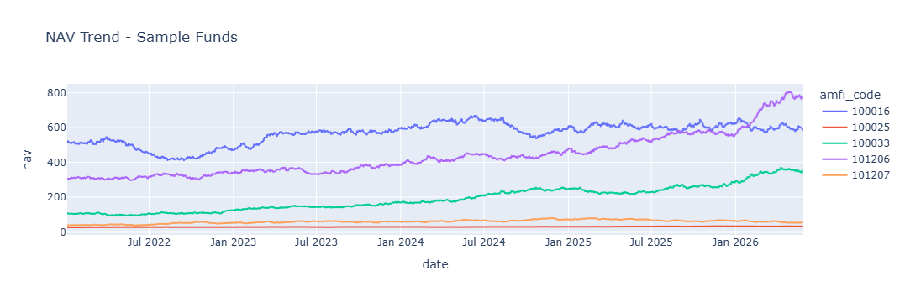
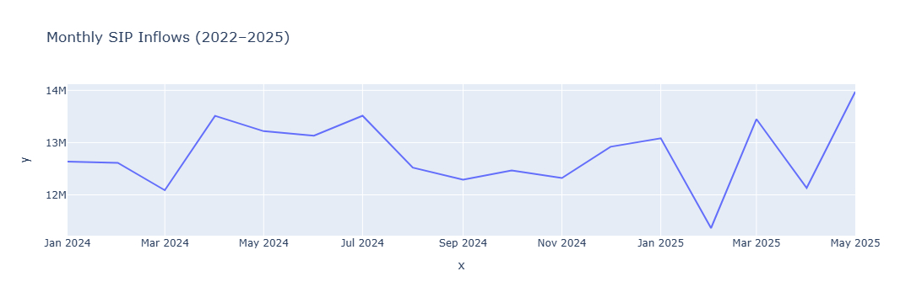

EDA HIGHLIGHTS
SIP inflows reached record highs.

Slide 6
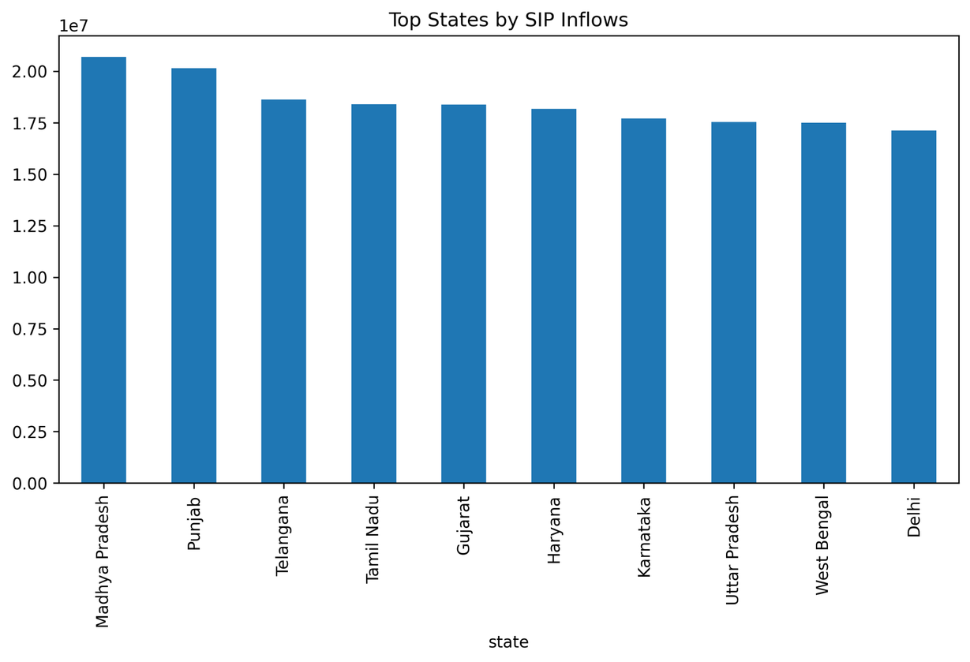
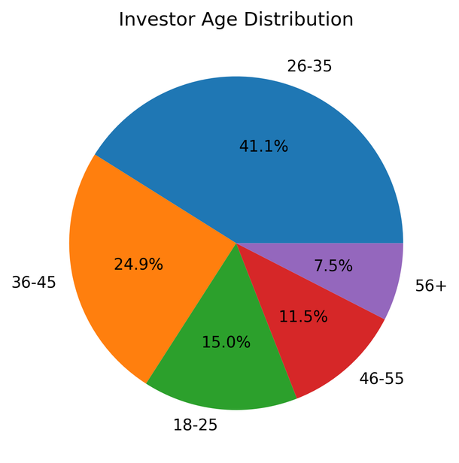
INVESTOR ANALYTICS
Insights :
Middle-aged investors contribute largest investment volume.
Metro cities dominate transaction amounts.
B30 participation continues to grow.

Slide 7
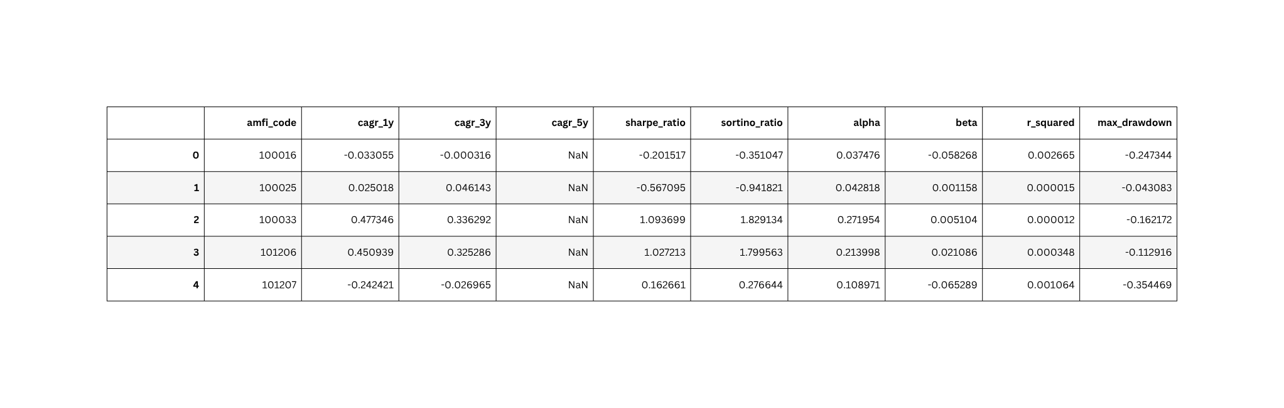
PERFORMANCE ANALYTICS
METRICS CALCULATED:
CAGR
Sharpe Ratio
Sortino Ratio
Alpha & Beta
Maximum Drawdown

Slide 8

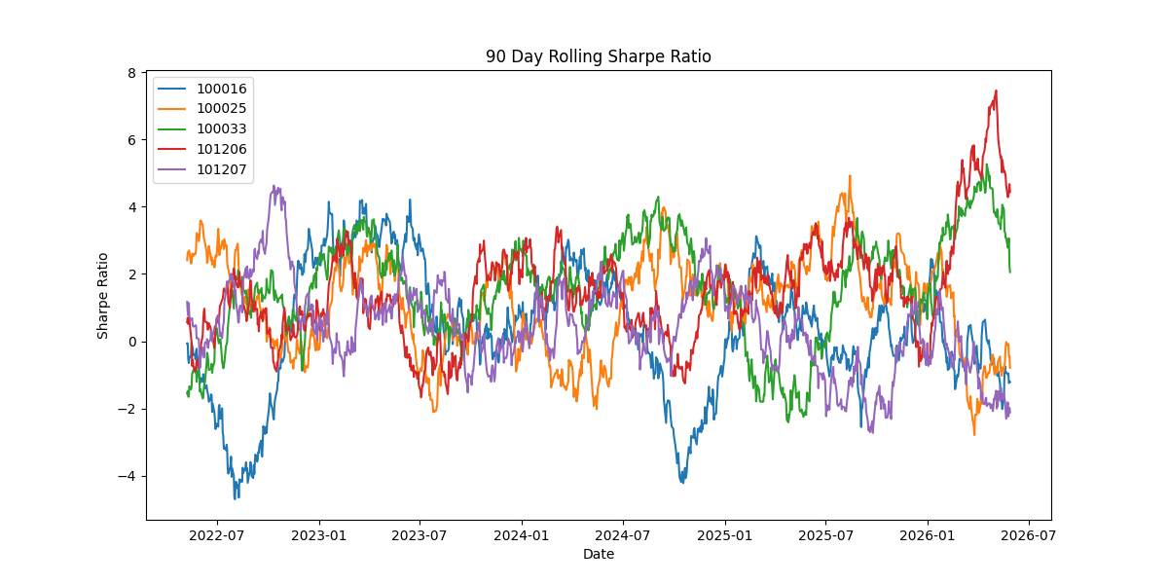
ADVANCED RISK ANALYTICS
Risk metrics:
Historical VaR(95%)
Conditional VaR(CVaR)
Rolling 90-Day Sharpe ratio
Example result:
Fund 101207: VaR = -2.60% | CVaR = -3.25%

Slide 9
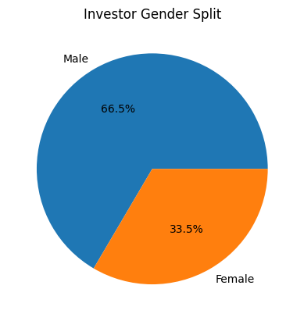
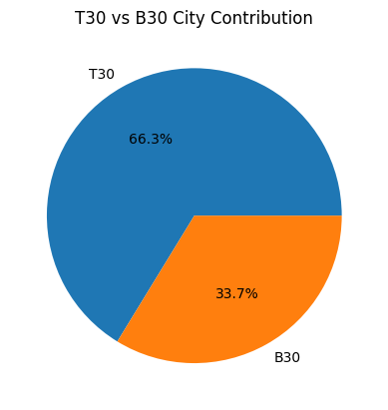
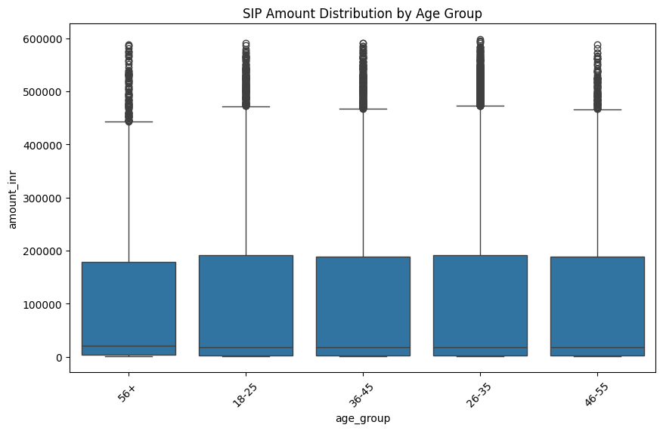
COHORT & SIP ANALYSIS
INVESTOR COHORTS:
Grouped by first transaction year.
Finding: 2025 cohort invested more on average than 2024 cohort.

Slide 10
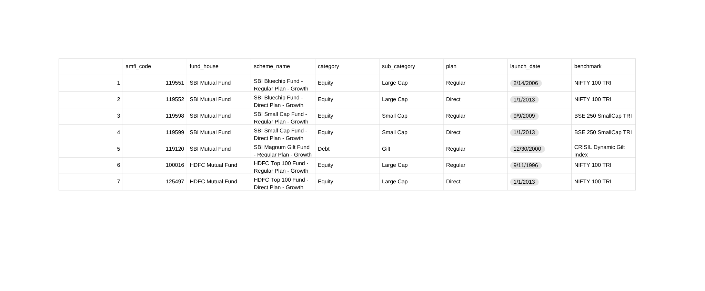
RECOMMENDATION ENGINE & HHI
Recommendation Engine
Input: Low / Moderate / High risk appetite
Output: Top 3 funds by Sharpe Ratio within the selected risk category
Portfolio Concentration
HHI (Herfindahl-Hirschman Index) measures sector concentration.
Fund 119092 recorded the highest concentration score.

Slide 11
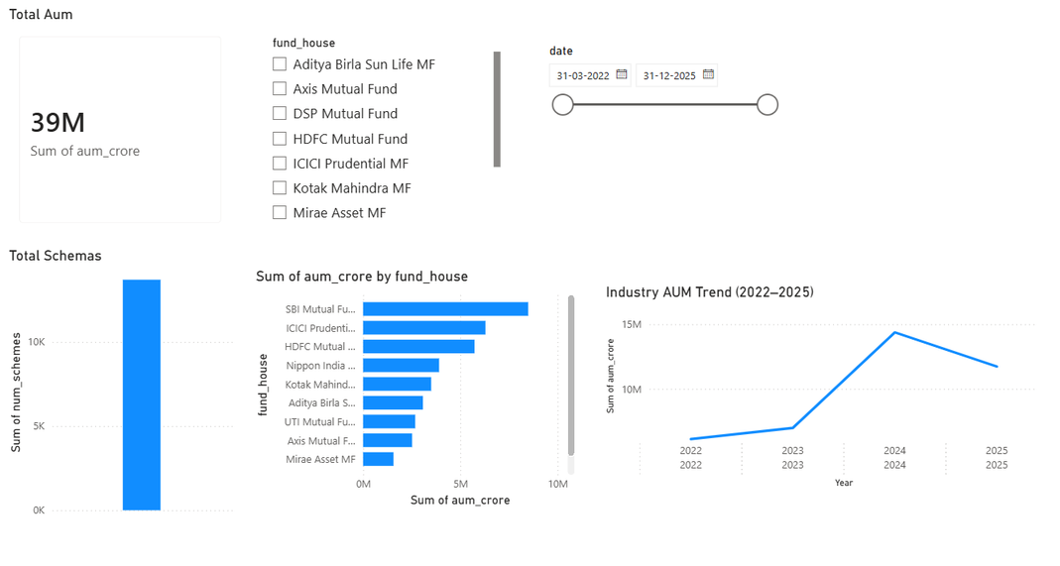
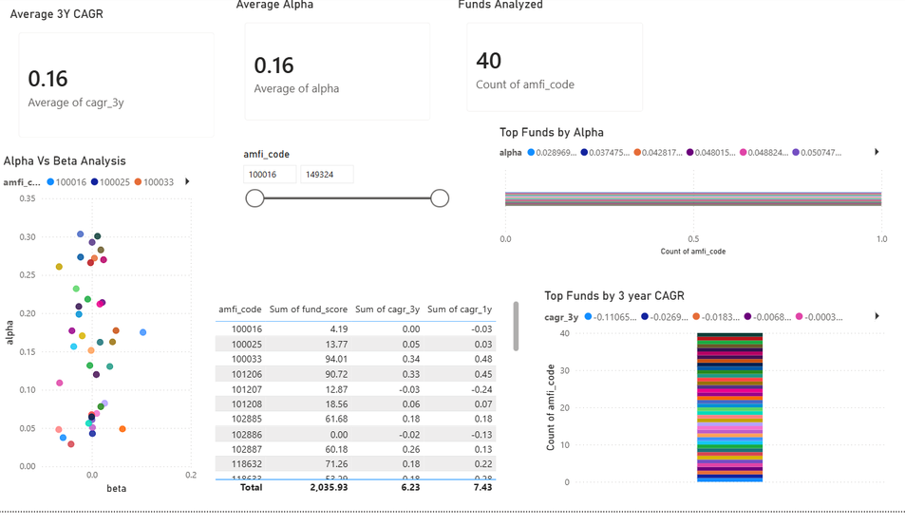
POWER BI DASHBOARD
DASHBOARD PAGES:
Industry Overview
Fund Performance
Investor Analytics
SIP & market trends

Slide 12
CONCLUSION & FUTURE WORK
Built an end-to-end mutual fund analytics solution.
Generated insights into fund performance and investor behavior.
Developed risk analytics and recommendation models.
Created an interactive Power BI dashboard.
FUTURE ENHANCEMENTS:
Real-time NAV integration
Machine learning recommendations
SIP churn prediction
Cloud dashboard deployment

Slide 13
THANK YOU

